Slide 1


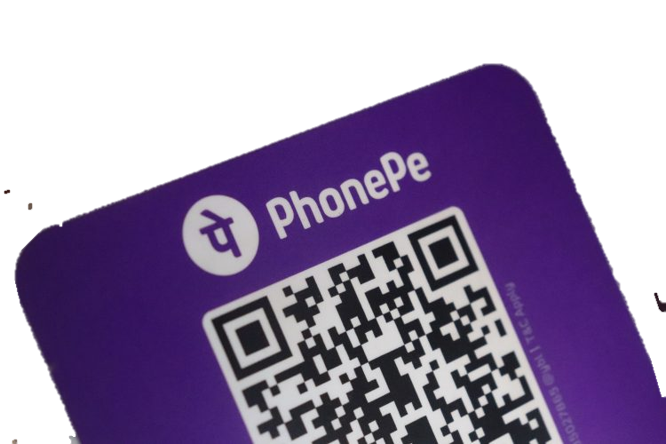
CASE STUDY
TRANSFORMING DIGITAL PAYMENTS
Created by : Manisha Mangwani
Email ID: manishamangwani21@gmail.com

Slide 2
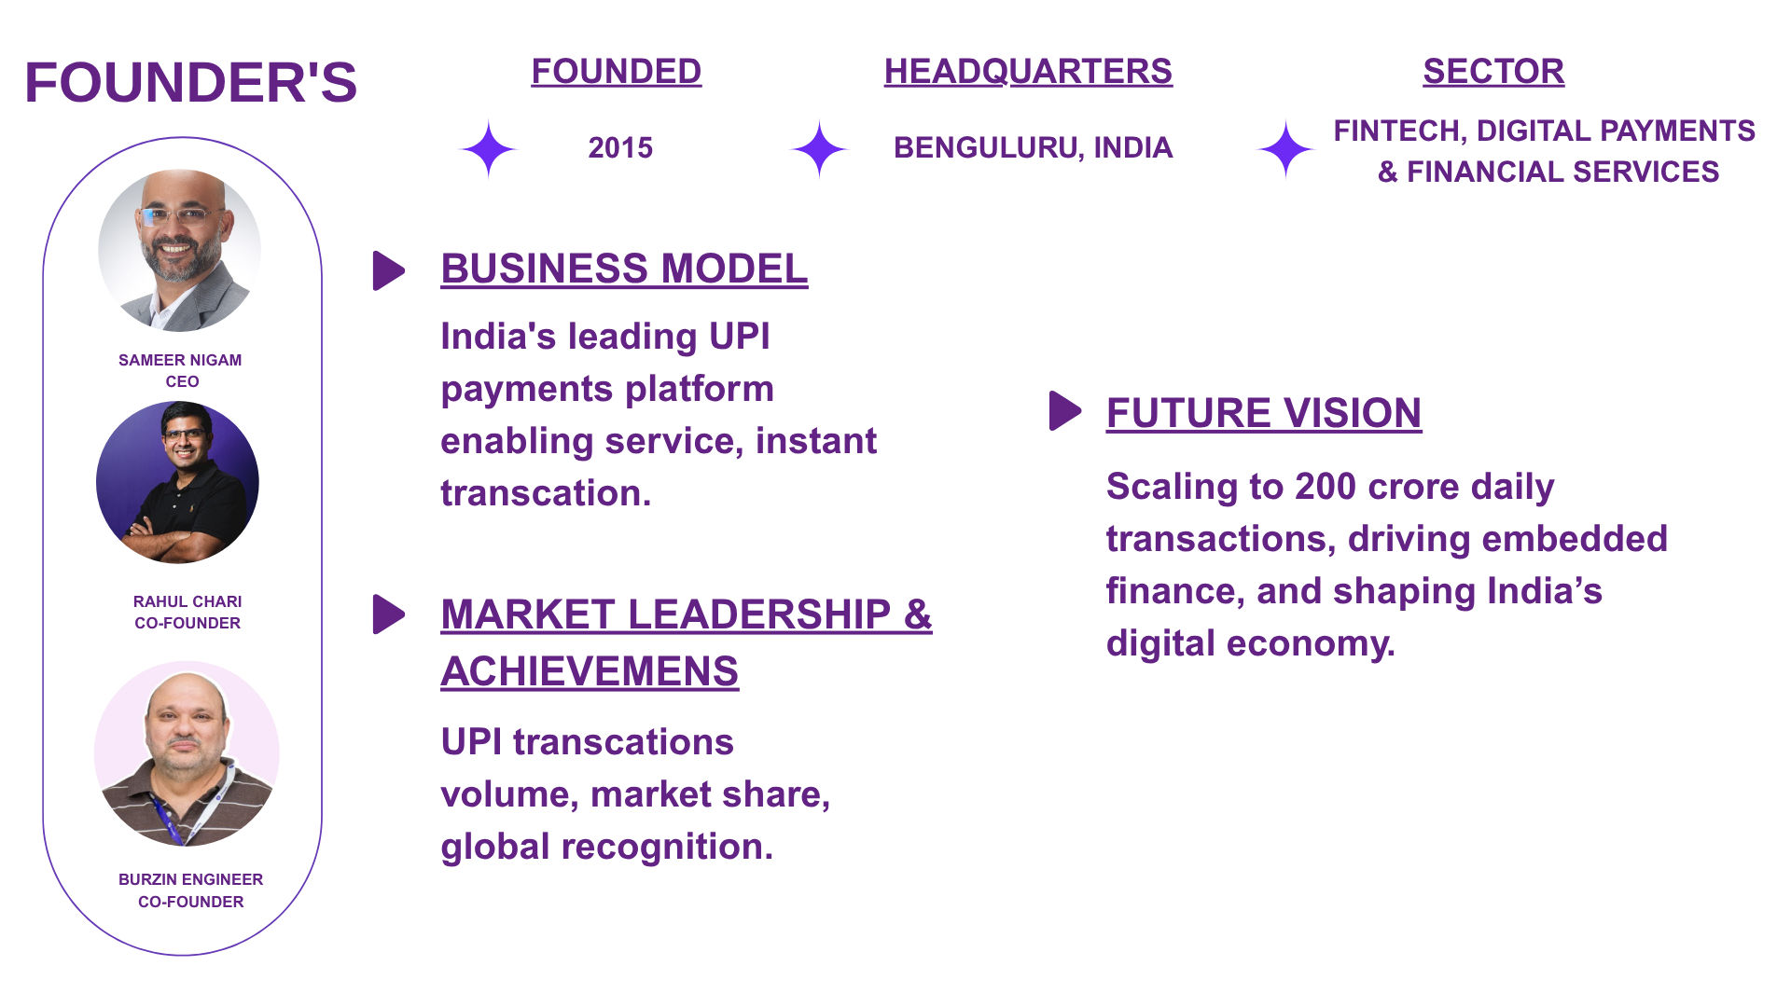
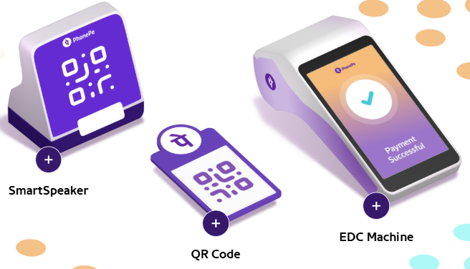





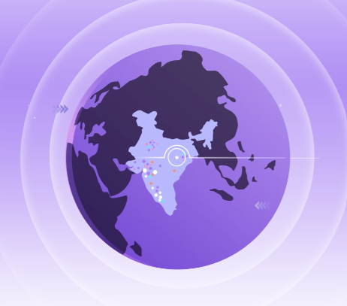

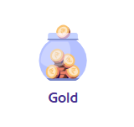
COMPANY OVERVIEW
CONSUMER SOLUTIONS
BUSINESS SOLUTIONS
Sources: https://www.phonepe.com/press/annual-report/PhonePe-Annual-Report-FY-23-24.pdf

Slide 3
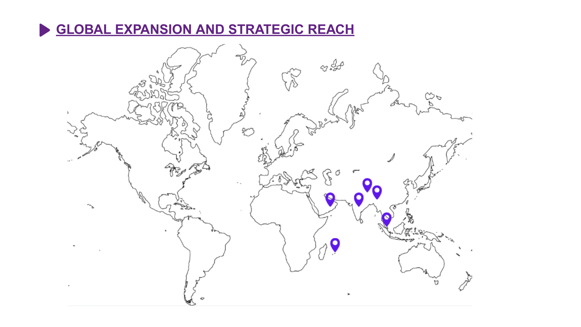
Sources: https://www.phonepe.com/press/annual-report/PhonePe-Annual-Report-FY-23-24.pdf

Slide 4

INDUSTRY OVERVIEW
Market Size & Growth:
$310 Billion Market (2024)
20% CAGR, to $1.2 Trillion by 2030 (NITI Aayog)
Drivers: Digital India push, UPI adoption, young demographic.
Key Players & Competitive Landscape:
Payments: PhonePe (47%), Google Pay (37%), Paytm (7%)
Lending: NBFCs & Digital Lenders (e.g., Paytm, Navi, Policybazaar)
Dynamics: Intense competition, focus on user experience & innovation.
Trends & Disruptors:
Embedded Finance: Seamless integration of financial services.
AI/ML: Personalization, fraud detection, credit scoring.
Open Banking: Data sharing for new product development.
Challenges & Opportunities:
Challenges: Regulatory evolving, cybersecurity threats.
Opportunities: Rural penetration, SME lending, cross-border payments.
Sources: https://www.financialexpress.com/business/banking-finance-indian-fintech-market-to-achieve-1-trillion-aum-by-2030-report-2623959/

Slide 5
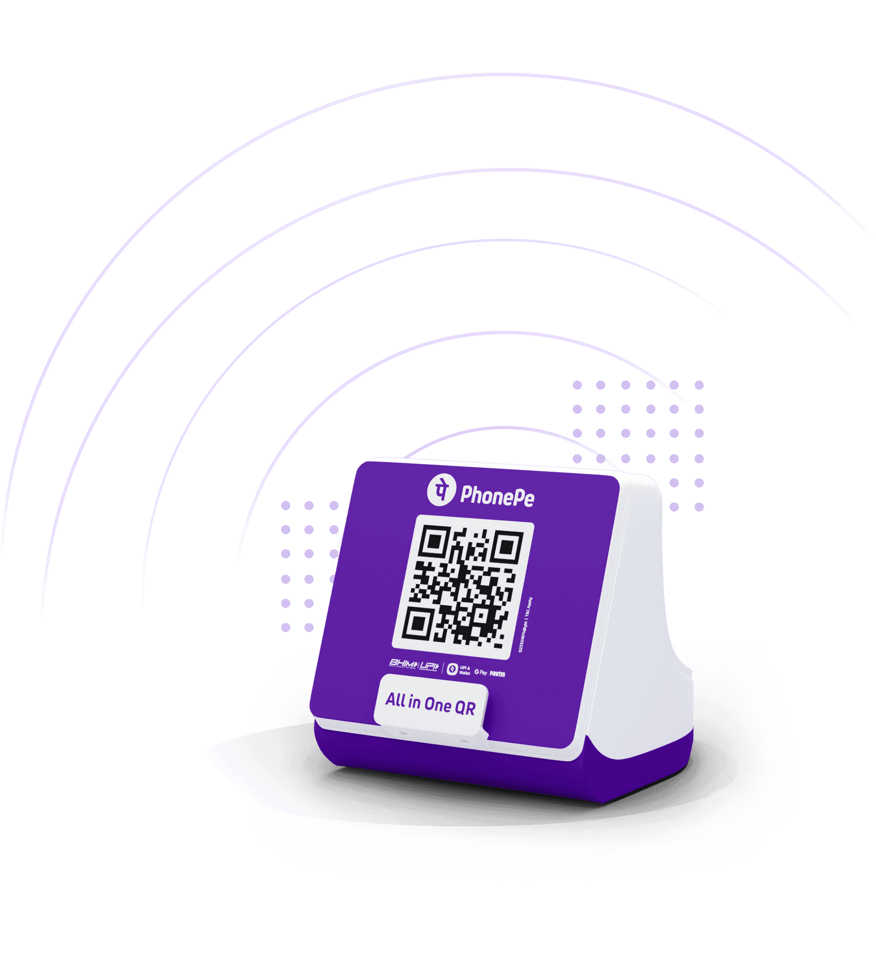
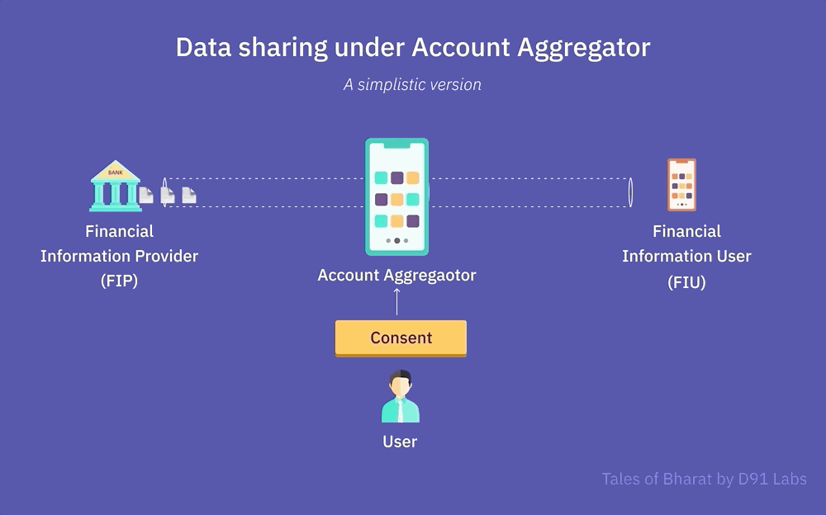

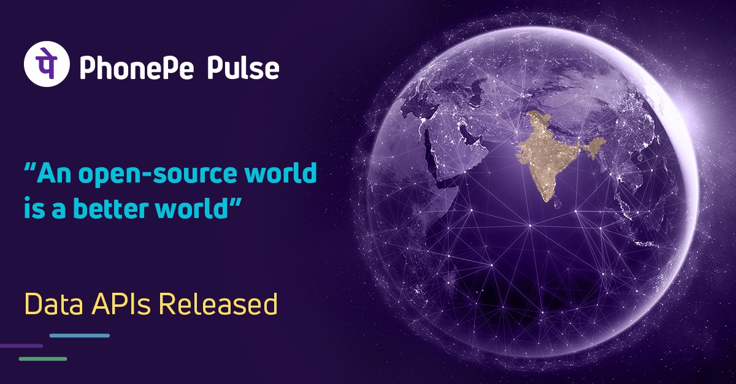
UNIQUE SELLING POINT (USP)
PhonePe has introduced several unique features that distinguish it from its competitors in the Indian fintech landscape. Here are some of the standout aspects.
PhonePe Smart Speaker: Offline Payment Notifications
Account Aggregator Services
PhonePe Switch: In-App Mini-App Platform
PhonePe Pulse: Open Data Insights
Device Tokenization for Enhanced Security
TOKEN
Sources: https://insightforge.beehiiv.com/p/the-phonepe-story-how-a-vision-became-india-s-fintech-giant, https://www.inventiva.co.in/stories/how-did-phonepe-succeed-payment-app/

Slide 6
SWOT ANALYSIS
PhonePe has introduced several unique features that distinguish it from its competitors in the Indian fintech landscape. Here are some of the standout aspects.
Strengths
Weaknesses
Opportunities
Threats
Market leadership in UPI
Backed by Walmart (via Flipkart)
High merchant penetration
Heavy competition from Google Pay, Paytm
Monetization still maturing
Cross-border payments
Expanding into lending, wealth management
Regulatory risks (RBI, NPCI)
Data privacy concerns
Sources: https://www.pwc.in/assets/pdfs/consulting/financial-services/fintech/publications/the-changing-face-of-financial-services-growth-of-fintech-in-india-v2.pdf

Slide 7
PESTEL ANALYSIS
.
POLITICAL
ECONOMIC
SOCIAL
TECHNOLOGICAL
ENVIRONMENTAL
LEGAL
PhonePe's growth is largely driven by government support for digital inclusion and UPI adoption.
PhonePe's main revenue still comes from digital payments, highlighting its struggle to profit from newer services like insurance, credit, and stockbroking.
In November 2021, PhonePe executed a ₹135 crore ESOP buyback, benefiting 75% of employees with over a year of service.
PhonePe uses AI and data analytics to personalize services, suggest financial products, and prevent fraud.
The company's digital nature suggests a lower carbon footprint compared to traditional banking operations.
PhonePe faced legal issues in 2017 when ICICI Bank blocked its transactions over UPI compliance concerns, but the matter was later resolved.
Sources: https://research.contrary.com/company/phonepe, https://economictimes.indiatimes.com/tech/startups/ipo-bound-phonepe-still-tethered-to-epay-despite-all-out-push/articleshow/121252155.cms?

Slide 8
Established players with strong brand/scale less vulnerable to new competition like PayTm, PhonePe
Strong brand & regulatory standing reduce new entrant risk.
PORTERS FIVE FORCES
Highly competitive landscape: Players like PhonePe, GPay, and Paytm battle for market share and user loyalty.
Threat of New Entrants
Bargaining Power of Suppliers
Bargaining Power of Buyers
Threat of Substitutes
Competitive Rivalry
PORTER’S FIVE FORCES
Reliance on strong supplier ties (banks, payment gateways, data providers) offers a competitive advantage.
Exclusive integrations with key suppliers provide strategic edge (e.g., Google Pay & Apple).
Peers with stronger user lock-in (ecosystem services, rewards, ease of use) are less vulnerable.
PhonePe’s cross-sell of mutual funds, insurance, and gold increases stickiness.
Users might shift to alternatives like cash, credit cards, or other apps.
Peers with more comprehensive ecosystems (e.g., PhonePe Switch or Paytm Mall) may reduce churn risk
Sources: : https://www.phonepe.com/press/annual-report/PhonePe-Annual-Report-FY-23-24.pdf

Slide 9
FINANCIAL PERFORMANCE
Sources: https://www.phonepe.com/press/annual-report/PhonePe-Annual-Report-FY-23-24.pdf, https://www.npci.org.in/what-we-do/upi/upi-ecosystem-statistics

Slide 10
VALUATION ANALYSIS
Company | Status | Revenue (₹ Cr) | EBITDA (₹ Cr) | Net Income (₹ Cr) | EV (₹ Cr) | Revenue Growth (%) | EV/EBITDA | EV/Revenue
Paytm (One 97) | Public | 10,542.7 | 558.8 | -1,422 | 50,161.0 | 25% | 89.77X | 4.76X
Mobiwik | Public | 875.00 | 37.2 | 14.08 | 1,949.0 | 62% | 52.39x | 2.23X
PhonePe’s Valuation Based on Public Entities
Metric | Value
Revenue (latest) | ₹5,725 Cr
EV/Revenue Avg (peers) | 3.5x
Implied Valuation | =₹ 5,725 × 3.5
Valuation (₹ Cr) | ₹ 20,037.5 Cr
Sources: https://paytm.com/document/ir/agm/fy/-24/Paytm_Annual_Report_2024.pdf, https://www.bseindia.com/xml-data/corpfiling/AttachHis/61bd3477-0728-46fa-9e62-319088c2f276.pdf

Slide 11
PEER ANALYSIS
Sources: https://www.npci.org.in/statistics

Slide 12
PRECEDENT TRANSACTIONS RELATED TO FINTECH INDUSTRY
PhonePe's Acquisitions:
January 2023: $350 million from General Atlantic.
March 2023: $200 million from Walmart.
OpenQ & WealthDesk (2022): Combined $75M deal for wealth management platforms.
Indus OS (2021): Acquired for $60M to boost "Switch" platform content.
Paytm's Acquisitions:
CreditMate (2021): Acquired to strengthen digital lending business.
MobiKwik's Investments:
Bajaj Finance (2017): Invested ₹225 Cr for 10.83% stake, boosting financial services.
Series B & C Funding (2015-2016): Raised $75M from investors (Sequoia, Cisco, Amex) for expansion & tech.
Sources: https://www.reuters.com/markets/asia/indias-phonepe-raises-350-million-12-bln-valuation-2023-01-19/, https://economictimes.indiatimes.com/tech/funding/phonepe-racks-up-additional-200-million-from-walmart-in-ongoing-fundraise/articleshow/98723433.cms?from=mdr, https://www.livemint.com/companies/news/paytm-group-takes-over-complete-ownership-of-creditmate-11633180423299.html

Slide 13
CONCLUSION
As India’s largest UPI player, with over 48% market share and more than 5 billion monthly transactions, our fintech platform stands at the forefront of digital payments innovation.
From pioneering solutions like Credit on UPI and UPI ATM withdrawals to extending digital access through UPI Lite and UPI 123Pay, we’re reshaping how India transacts.
With 30+ global partnerships and government-backed initiatives, we’re driving UPI’s international adoption while expanding into lending, insurance, and wealth management.
Positioned for the future, we aim to scale alongside UPI’s exponential growth, leveraging AI and embedded finance to deliver secure, seamless, and inclusive financial services for all.

